Slide 1
CS 35L: Software Construction Lab
Aditi Mithal
Week 1 Lecture 2

Slide 2
Course Logistics
3 credit course
9 assignments (Lab + HW), 1 report , 1 Final exam
SEASnet account is mandatory!
Use piazza for questions (https://piazza.com/ucla)
Office Hours:
Professor Eggert: Mondays 14:15–15:15 and Thursdays 16:00–17:00. Engineering VI 363
Aditi: Tues 2:30-4:30pm; @3256S-F BH, my email id : aditimithal@cs.ucla.edu

Slide 3
Your SEASnet account
Create an account https://www.seas.ucla.edu/acctapp/
Connect to linux server
ssh <seasnet username>@lnxsrv09.seas.ucla.edu (Shell – recommended!)
Or, install PuTTY SSH client (on Windows) : Follow instructions on http://www.seasnet.ucla.edu/lnxsrv/

Slide 4
Linux commands

Slide 5
The Basic: Moving Around
pwd: print working directory
cd: change working directory
~: home directory
.: current directory
/: root directory, or directory separator
..: parent directory

Slide 6
The Basics: Dealing with Files
mv: move a file (no undos!)
cp: copy a file
rm: remove a file
touch <filename>: creates a file
mkdir: make a directory
rmdir: remove a directory
ls: list contents of a directory
-d: list only directories
-a: list all files including hidden ones
-l: show long listing including permission info
-s: show size of each file, in blocks

Slide 7
The Basics: Dealing with Files (Mini-task)
Create two files
$ touch foo.txt $ touch bar.txt
Add text into the files and print it
echo "Cat" > foo.txt
echo "Dog" > bar.txt
cat foo.txt bar.txt (concatenates the output)
Output:
Cat
Dog

Slide 8
The Basics: History
<up arrow>: previous command
<tab>: auto-complete
!!: replace with previous command
history : gives you all the commands typed previously
!<string>: executes last command which has <string>

Slide 9
The Basics: Redirection
> file: write stdout to a file
>> file: append stdout to a file
< file: use contents of a file as stdin

Slide 10
Task 1 (Hint: use “wc” command)
Create 2 .txt files and add multiple lines in each one of them
Get the line count for each of these files
Cat abc.txt | wc -l

Slide 11
The Basics: find
-type: type of a file (e.g,, directory, symbolic link)
-perm: permission of a file
-name: name of a file
-ls: list current file

Slide 12
find contd…
?: matches any single character in a filename
*: matches zero or more characters in a filename
[]: matches any one of the characters between the brackets. Use ‘-’ to separate a range of consecutive characters.
Examples:
find . -name my*
find . -name my* -type f
find / -type f -name myfile

Slide 13
wh commands
whatis <command>: returns Name section of man page
whereis <command>: locates the binary, source, and manual page files for a command
which <command>: locates only the binary

Slide 14
diff command
A file comparison utility that outputs the differences between two files.
Usage:
diff file1 file2

Slide 15
wget command
A computer program that retrieves content from web servers
Usage
wget <URL>

Slide 16
The Basics: Look These Up
head
tail
du
top
ps
kill
diff
cmp
echo
find
wc
sort
ping 8.8.8.8
diff
wget <url>

Slide 17
The Basics: Changing File Attributes
ln : creates a link
Hard links : Point to physical Data
Additional name for an existing file
ln file1 hlink1
Soft Links/ Symbolic Links (-s): Point to file
ln –s <source file> <my file>
touch: update access & modification time to current time
touch filename
touch –t 01311759.30 filename
Change filename’s access & modification time to (January day 31 time 17:59:30)

Slide 18
Text editors
Emacs and vim

Slide 19
vi editor
Open a file - vi <filename> or vim <filename>
Close a file - :q
Save a file - :w
Save and close a file - :wq

Slide 20
Emacs editor (We will be using Emacs for this course)
Almost like a Windows text editor, but much more powerful
Run emacs on the linux server
C-h r (manual) and C-h t (tutorial)
All emacs commands start with ‘C’ or ‘M’
‘C’ = ctrl; ‘M’ = alt (windows)/ option (Mac)
Start emacs
emacs <filename>
Exit emacs
C-x C-c

Slide 21
Basic emacs editing
Insert text by simply typing it
Undo by typing C-x u
Save changes by typing C-x C-s
Copy, cut, paste
C-space (starts selecting region)
M-w (copy a region)
C-w (cuts a region)
C-k (kill a line)
C-y (yank/paste)

Slide 22
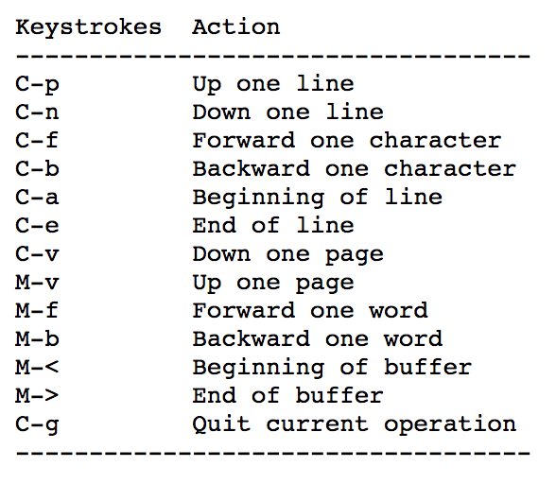
Moving around

Slide 23
More emacs commands
Search – C-s
Replace – M-%
Accessing menu – F10
Switch buffer – C-x b
Switch current window – C-x o
Kill the current window – C-x 0 (zero)
Help – C-h

Slide 24
Directory edit (dired) (C-x d)
Creates an Emacs buffer containing list of directory contents
Allows you to operate on files
Allows you to navigate filesystem
+ - new directory, C-x C-f new file in directory, g - refresh dired buffer
! - run shell command
https://www.gnu.org/software/emacs/refcards/pdf/dired-ref.pdf

Slide 25
EMACS tutorial links
http://bit.ly/2CQy3H8 (some basic commands)
http://stanford.io/2CTWNyl

Slide 26
Todo
Read the tutorial and manual
Navigate and get used to emacs in the next 15 min
We’ll have a small task after this

Slide 27
Assignment submission specifics

Slide 28
Submission details
Go through Homework 1 again on CCLE, there may be minor changes in the wording of the assignment (Due: Oct 6th)
Submit on CCLE under your Lab <number> (if specified)
No submissions will be accepted via email
Test your files on seasnet before submitting
key1.txt should record keystrokes of Homework
ans1.txt should have keystrokes and answers of the lab assignment
[I hope the lateness penalty policy is clear]
Assignment 7 requirements
You will have to buy a BeagleBone Green which will be required for Assignment 7.

Slide 29
Assignment 1: Example key1.txt
key1.txt is for HOMEWORK section
Exercise 1.1
C-s H E L L O W O R L D
…
…
Exercise 1.2
C-s H T M L
…
so on…

Slide 30
Assignment 1: Example ans1.txt
ans1.txt is specifically for LABORATORY section
1. Here is the answer to question 1
2. Here is the answer to question 2
3. Here is the answer to question 3
…..
Rest of the guidelines are on the link

Slide 31
Plagiarism Policy
Any instance of cheating is intolerable – serious consequences
You are requested to do the assignments on your own and not refer to any public forums or github
Do not put your assignments on a public platform

Slide 32
Task 2
Create a cpp file (print “hello”) using emacs
Run the file
Edit the file (print “hello again”) using emacs and save it as a new file
Run the new file
Solution:
C-x s, C-x C-w

Slide 33
Cpp program
#include<iostream>
using namespace std;
int main(){
cout<< “Hello”;
return 0;
}
Compiling instr:
g++ -o filename filename.cpp
./filename

Slide 34
Task 3
Create 2 txt files (insert some lines) using emacs
Find the difference between both of them using a linux command
Solution:
diff file1 file2

Slide 35
Tasks
Create a file using emacs. Try the Cut/Copy/Paste commands.
Write a command to list all files as well as the hidden files in your home directory.
Remove a non-empty directory.
Assign the value 10 to a variable x, 15 to a variable y; Compute and display their addition in the shell. Do not use any editor!
Echo $(( ….. ))
Man expr
Create a directory ‘test’ and ‘subtest’ inside test (in the home directory) without using mkdir twice. (mkdir –p test/subtest)
Create empty files ans.txt, ans.html, assign.txt, assign.html
Find all directories and subdirectories in your home directory
find . –type d
Find all files in the test directory starting with ‘a’ (find ./test –type f –name ‘a*’)
Find all text files inside test directory
find ./test –type f –name ‘*.txt’
Find all html files inside test directory
Find ./test –type f –name ‘*.html’
Delete test directory from the home directory (rm –rf <dirname>)
Notes:
echo $(($a + $b))

Slide 36
Lab 1: Hints
Hints for lab questions:
man man
which
find
readlink
--version
man chmod
man find
Whereis, find
find, sort
localedef

